Slide 1
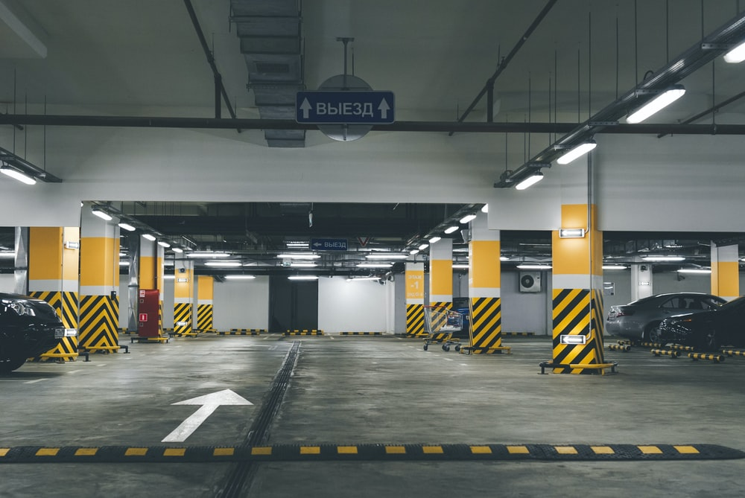
PANIMALAR ENGINEERING COLLEGE
DEPARTMENT OF COMPUTER SCIENCE AND ENGINEERING
ONLINE PARKING-SPACE SHARING MECHANISM WITH PRIVACY PROTECTION
FEMINA S 211418104059
KIRTHIGA N 211418104125
KIRUTHIKA M 211418104126
GUIDED BY:
S.T. SANTHANA LAKSHMI

Slide 2
ABSTRACT
Sharing private parking spots has indicated an incredible potential for tending to metropolitan gridlock and unexpected stopping issues in urban areas.
Planning to address the internet parking spots sharing issue while guaranteeing the protection of client stopping objective areas, we propose a novel objective privacy-preserving internet.
The internet parking spot sharing issue is formalized as a social government assistance expansion issue in a two-sided market, where parking spot suppliers and clients are viewed as dealers and purchasers.
At that point, these are based on standards that are intended to decide installments and repayment.
We examine the upper bound of the productivity loss of our plan. Broad assessment results exhibit that our plan cannot just accomplish great execution with respect to social government assistance, Supplier fulfillment proportion, protection conservation.

Slide 3
EXISTING SYSTEM
We presently model the internet parking spot sharing issue as a two-sided market, where the PSSs go about as dealers and the PSCs go about as purchasers.
The market will be set off when there are purchasers and dealers.
The framework works in a period opened style. The time allotment is set by the representative and the schedule opening is 60 minutes.
Likewise, the PSSs and the PSCs can show up and withdraw from the market progressively, without advance information on the bartering.

Slide 4
DISADVANTAGES
It is not represent parking spaces and slots.
It is does not have authorized parking slots.
It requires large database.
It does not have reserved for particular timing.

Slide 5
PROPOSED SYSTEM
The proposed system of project is that provides easy way of reserving a parking space online using web portal.
It overcomes the problem of finding a parking space in areas that unnecessarily consumes time. Hence, this project offers a web application based reservation system where users can view various parking spaces and select nearby or specific area of their choice to view whether space is available or not.
If the booking space is available, then user can book it for specific time slot.
The booked space will be marked and will not be available for anyone else for the specified time.

Slide 6
ADVANTAGES
It is representing clearly with maps.
It has authorized parking slots with authorized address.
It is so easy to use with simple UI.
It has reserved for particular timing.
Users can get details about parking areas for particular locations.
The system provides a view of the parking spaces.
It excludes the need of human efforts for managing parking spaces.
It is representing clearly with clear locations.
It has authorized parking slots with authorized address.
It is so easy to use with simple User Interface.
It has reserved for particular timing.

Slide 7
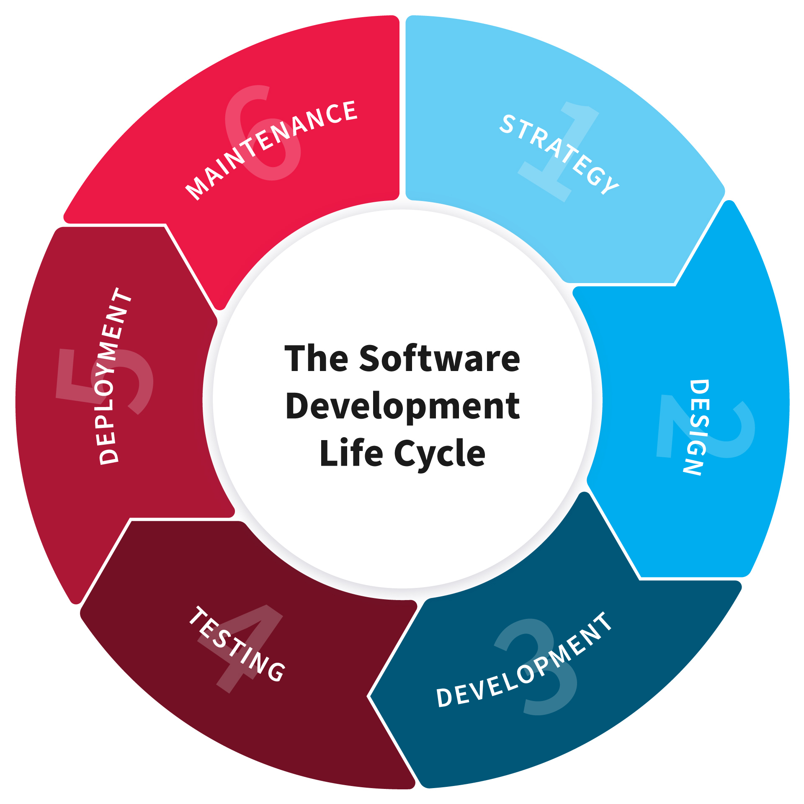
SDLC DIAGRAM

Slide 8
TIMELINE CHART

Slide 9
SYSTEM REQUIREMENTS
HARDWARE
PROCESSOR : Intel Core i3.
RAM : 4 GB
MONITOR : 15” COLOR
HARD DISK : 25 GB
SOFTWARE
Front End : HTML, BOOTSTRAP, JAVASCRIPT
Back End : MYSQL, PHP
Operating System : Windows 07
Software : NOTEPAD, XAMPP SERVER

Slide 10
Thank you!

